Slide 1
HDFS
By
Prof. Prakash Patel
Asst.Prof.-it dept.
git

Slide 2
What is HDFS?
Hadoop File System was developed using distributed file system design.
It is run on commodity hardware. HDFS is highly fault-tolerant and designed using low-cost hardware.
HDFS holds very large amount of data and provides easier access.
HDFS also makes applications available to parallel processing.

Slide 3
Features of HDFS
It is suitable for the distributed storage and processing.
Hadoop provides a command interface to interact with HDFS.
The built-in servers of namenode and datanode help users to easily check the status of cluster.
Streaming access to file system data.
HDFS provides file permissions and authentication.

Slide 4
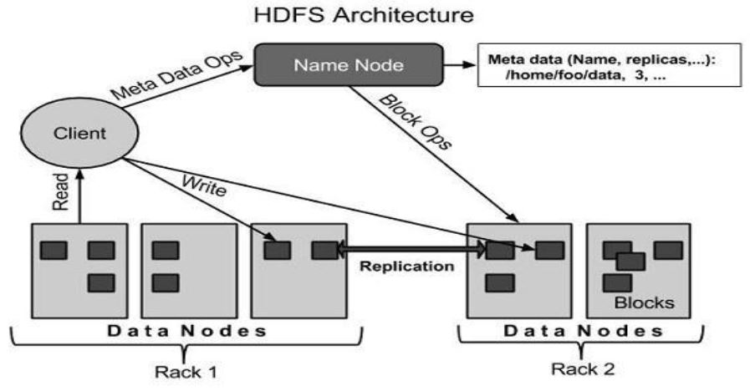
Architecture of HDFS
Given below is the architecture of a Hadoop File System.

Slide 5
Elements of HDFS
Namenode
The namenode is the commodity hardware that contains the GNU/Linux operating system and the namenode software.
It is a software that can be run on commodity hardware. The system having the namenode acts as the master server and it does the following tasks:
Manages the file system namespace.
Regulates client’s access to files.
It also executes file system operations such as renaming, closing, and opening files and directories.

Slide 6
Datanode
The datanode is a commodity hardware having the GNU/Linux operating system and datanode software.
For every node (Commodity hardware/System) in a cluster, there will be a datanode. These nodes manage the data storage of their system.
Datanodes perform read-write operations on the file systems, as per client request.
They also perform operations such as block creation, deletion, and replication according to the instructions of the namenode.

Slide 7
Block
Generally the user data is stored in the files of HDFS.
The file in a file system will be divided into one or more segments and/or stored in individual data nodes.
These file segments are called as blocks. In other words, the minimum amount of data that HDFS can read or write is called a Block.
The default block size is 64MB, but it can be increased as per the need to change in HDFS configuration.

Slide 8
Goals of HDFS
Fault detection and recovery: Since HDFS includes a large number of commodity hardware, failure of components is frequent. Therefore HDFS should have mechanisms for quick and automatic fault detection and recovery.
Huge datasets: HDFS should have hundreds of nodes per cluster to manage the applications having huge datasets.
Hardware at data: A requested task can be done efficiently, when the computation takes place near the data. Especially where huge datasets are involved, it reduces the network traffic and increases the throughput.

Slide 9
HDFS Operations
Starting HDFS
Initially you have to format the configured HDFS file system, open namenode (HDFS server), and execute the following command.
$ hadoop namenode -format
After formatting the HDFS, start the distributed file system. The following command will start the namenode as well as the data nodes as cluster.
$ start-dfs.sh

Slide 10
HDFS Operations
Listing Files in HDFS
After loading the information in the server, we can find the list of files in a directory, status of a file, using ‘ls’. Given below is the syntax of ls that you can pass to a directory or a filename as an argument.
$ $HADOOP_HOME/bin/hadoop fs -ls <args>

Slide 11
HDFS Operations
Inserting Data into HDFS
Assume we have data in the file called file.txt in the local system.
Step 1
You have to create an input directory.
$ $HADOOP_HOME/bin/hadoop fs -mkdir /user/input
Step 2
Transfer and store a data file from local systems to the Hadoop file system using the put command.
$ $HADOOP_HOME/bin/hadoop fs -put /home/file.txt /user/input
Step 3
You can verify the file using ls command.
$ $HADOOP_HOME/bin/hadoop fs -ls /user/input

Slide 12
Retrieving Data from HDFS
Assume we have a file in HDFS called outfile. Given below is a simple demonstration for retrieving the required file from the Hadoop file system.
Step 1
Initially, view the data from HDFS using cat command.
$ $HADOOP_HOME/bin/hadoop fs -cat /user/output/outfile
Step 2
Get the file from HDFS to the local file system using get command.
$ $HADOOP_HOME/bin/hadoop fs -get /user/output/ /home/hadoop_tp/

Slide 13
Shutting Down the HDFS
You can shut down the HDFS by using the following command.
$ stop-dfs.sh

